Slide 1
Performance and Usage
Analytics for NCAR’s Climate Model
Lolita Mannik
Regis University
National Center for Atmospheric Research (NCAR)
Summer Internships in Parallel Computational Science (SIParCS)

Slide 2
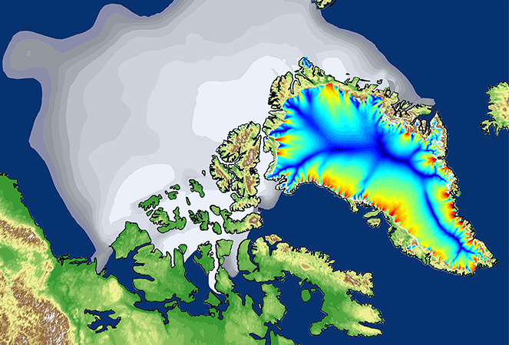

Overview
Background on Community Earth System Model
(CESM)
Model’s configuration
Data preparation and analysis
Key findings
Conclusion and future work
Image: http://www.cesm.ucar.edu/models/
Image: http://www.cesm.ucar.edu/models/

Slide 3

Goal
Analyze CESM performance
metadata
Establish basic metrics
Effect of a system upgrade on performance

Slide 4
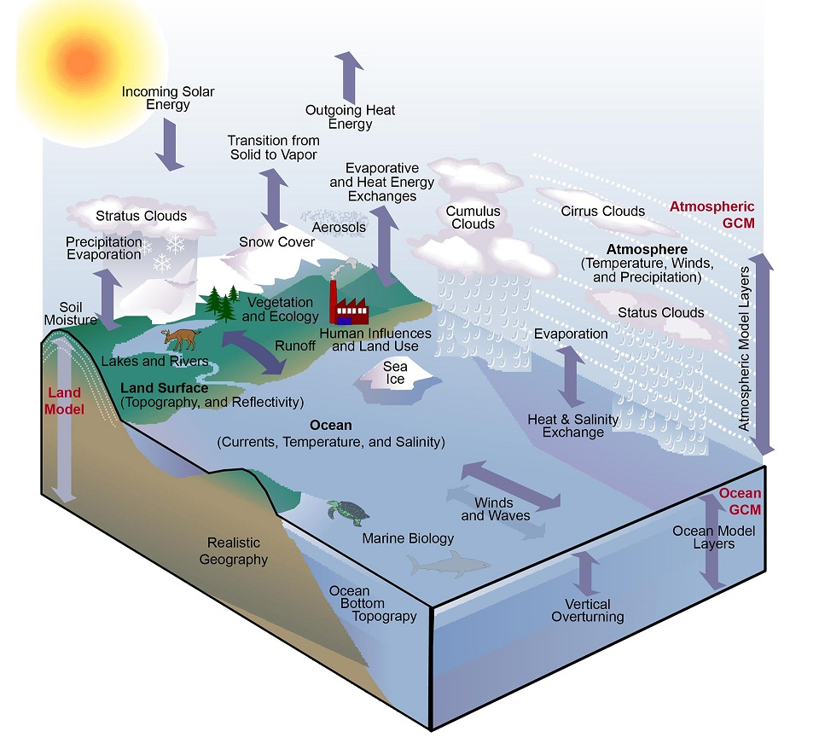
CESM Climate Model
Virtual laboratory
Freely available
Components:
Atmosphere
Land
Ocean
River
Sea and Land Ice
Wave
Image: Karl and Trenberth, 2003
CESM = Community Earth System Model
Image: http://www.cesm.ucar.edu/models/

Slide 5



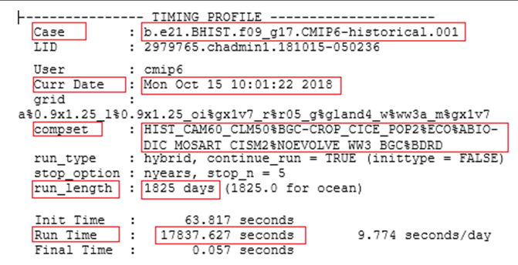
Method
.JSON

Slide 6
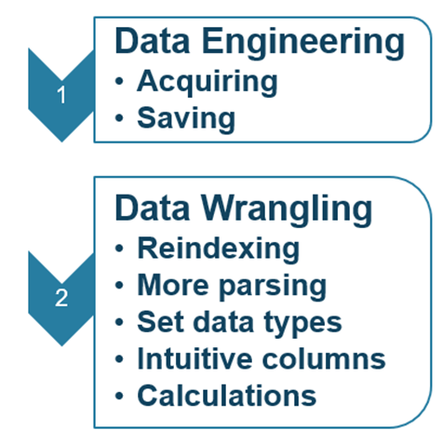

Method
.JSON
10010111010

Slide 7
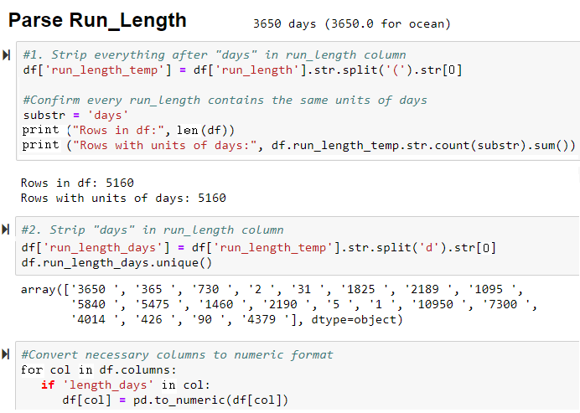
Data Wrangling

Slide 8
Data Wrangling

Slide 9
Data Wrangling

Slide 10
Data Wrangling

Slide 11
Data Wrangling

Slide 12
Data Wrangling

Slide 13
Data Wrangling

Slide 14


Method
.JSON
10010111010

Slide 15
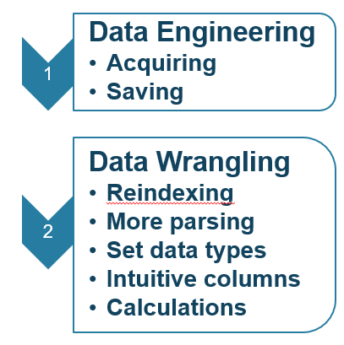
Method
.JSON
USABLE DATA!!
10010111010

Slide 16

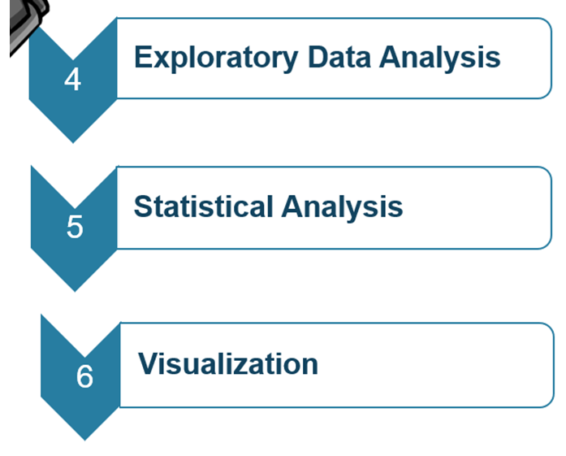


Method
52 unique
component configurations

Slide 17

Method
Pandas
Numpy
Scipy Stats
StatsModels

Slide 18

Method
MatPlotLib
Seaborn
Plotly

Slide 19

Analysis: Dataset Totals
416 Days
948
Unique Cases
21,785
Simulated Years
137,112,802
CPU Hours

Slide 20
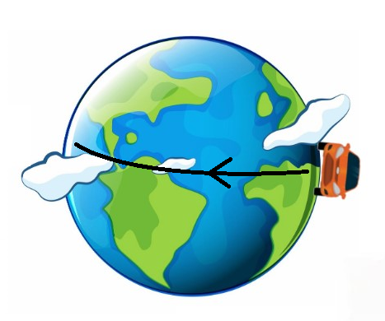

Power Equivalence
137,112,802
CPU Hours
or
218 trips around the equator in a Nissan Leaf
Annual power
for 180
Colorado homes

Slide 21
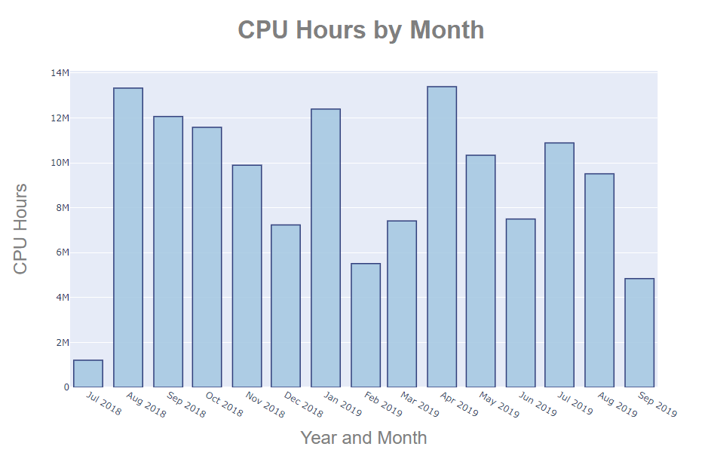
Analysis: Monthly Totals

Slide 22
Analysis: Grouping Atmospheric Configurations
Component string = compset
14 unique atmospheric components
*OBGC = Ocean Bio-geo-chemsitry
Init Atm Land Sea Ice Ocean River Land Ice Wave OBGC*

Slide 23

Analysis: Grouping Atmospheric Configurations
Component string = compset
14 unique atmospheric components
*OBGC = Ocean Bio-geo-chemsitry
Init Atm Land Sea Ice Ocean River Land Ice Wave OBGC*

Slide 24
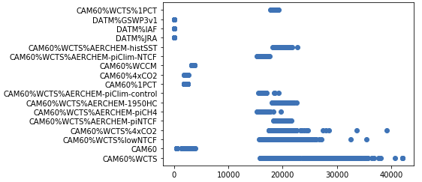
Analysis: Grouping Atmospheric Configurations
Atmospheric Configuration vs. Cost
Atmospheric Configuration
Cost of Atmospheric Component
(CPU-Hrs/Simulated Year)

Slide 25
Analysis: Grouping Atmospheric Configurations
Atmospheric Configuration vs. Cost
Atmospheric Configuration
Cost of Atmospheric Component
(CPU-Hrs/Simulated Year)
Mdel Cost
(CPU hrs/Simulated Year)

Slide 26
Analysis: Grouping Atmospheric Configurations
Atmospheric Configuration vs. Cost
Atmospheric Configuration
Cost of Atmospheric Component
(CPU-Hrs/Simulated Year)
Model Cost
(CPU hrsSimulated Year)

Slide 27
Analysis: Grouping Atmospheric Configurations
Atmospheric Configuration vs. Cost
Atmospheric Configuration
Cost of Atmospheric Component
(CPU-Hrs/Simulated Year)

Slide 28
Analysis: Grouping Atmospheric Configurations
Atmospheric Configuration vs. Cost
Atmospheric Configuration
Cost of Atmospheric Component
(CPU-Hrs/Simulated Year)

Slide 29
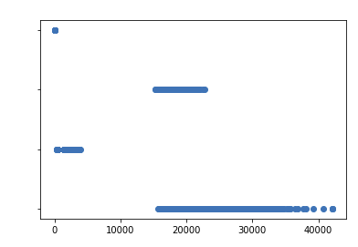
Analysis: Grouping Atmospheric Configurations
Atmospheric Configuration (Grouped)
vs. Cost
Data
AerChem + 1%
Atmospheric Configuration
CAM
Whole Atm
Cost of Atmospheric Component
(CPU-Hrs/Simulated Year)

Slide 30
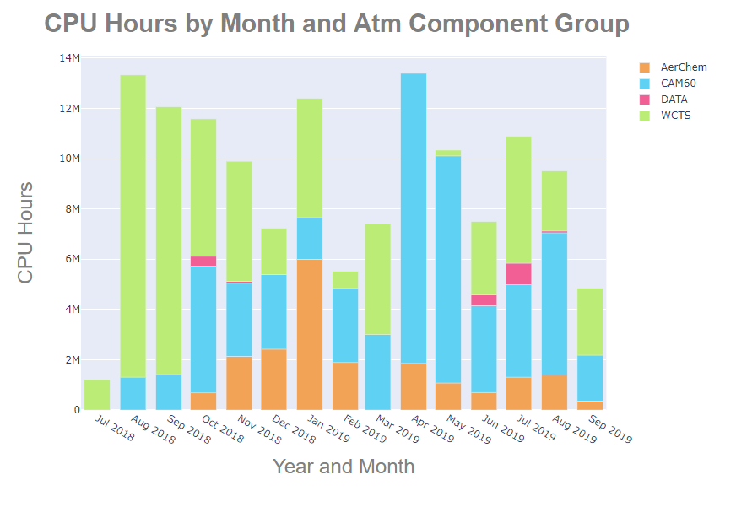
Analysis: Atmospheric Components

Slide 31

Analysis: System Upgrade
Cheyenne Supercomputer: 145,152 processors
Upgrade: June 25-July 5, 2019
Install SUSE Linux Enterprise Server Service Pack 4 to update security and support
Spoiler Alert!
Name of new supercomputer!

Slide 32
Analysis: System Upgrade
More maniacal subsetting . . .
By Case

Slide 33
Analysis: System Upgrade
More maniacal subsetting . . .
By Case
By Base

Slide 34
Analysis: System Upgrade
More maniacal subsetting . . .
By Case
By Base

Slide 35
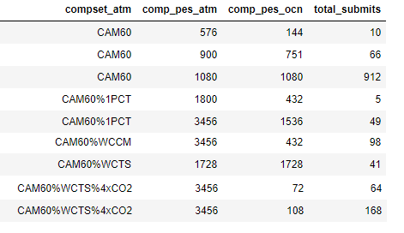
Analysis: System Upgrade
More maniacal subsetting . . .
By Case
By Base
By atmospheric component
+ atmospheric processors
+ oceanic processors

Slide 36
Analysis: System Upgrade
More maniacal subsetting . . .
By Case (811 data points, 3445 sim years, 14 cases)
By Base (1206 data points, 4271 sim years, 14 bases)
By atmospheric component
+ atmospheric processors
+ oceanic processors
(3113 data points,
12,493 sim years,
9 groups)

Slide 37
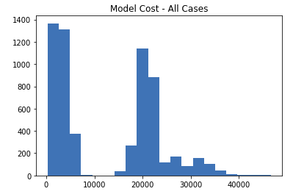
Analysis: System Upgrade
Tests for Normality
All
All - normalized
All - before/after
By case
By base
By group:
(atm compset/atm + ocn processors)

Slide 38
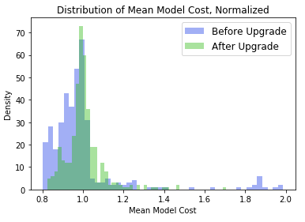
Analysis: System Upgrade
Tests for Normality
All
All - normalized
All - before/after
By case
By base
By group:
(atm compset/atm + ocn processors)

Slide 39
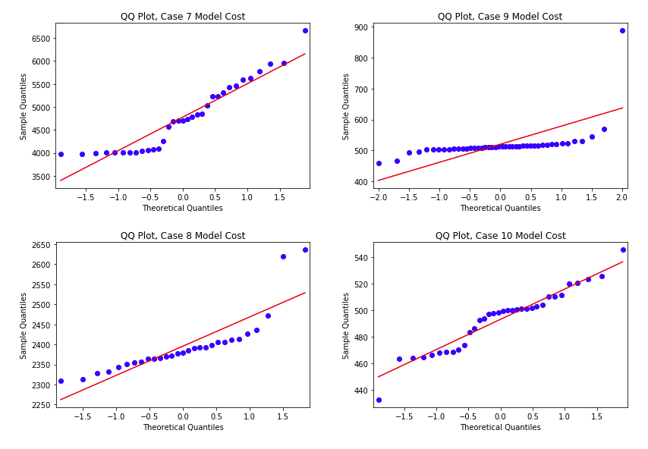
Analysis: System Upgrade
Tests for Normality
All
All - normalized
All - before/after
By case
By base
By group:
(atm compset/atm + ocn processors)
Statistical Tests for Normality:
Kolmogorov-Smirnoff
Shapiro-Wilk

Slide 40
Analysis: System Upgrade
Mean Model Cost Before Upgrade
vs.
Mean Model Cost After Upgrade
Calculated percent difference (% change) in means before and after the upgrade:
By case
By base
By group
Determined whether there was statistical significance in the means using Kruskal Wallis test

Slide 41
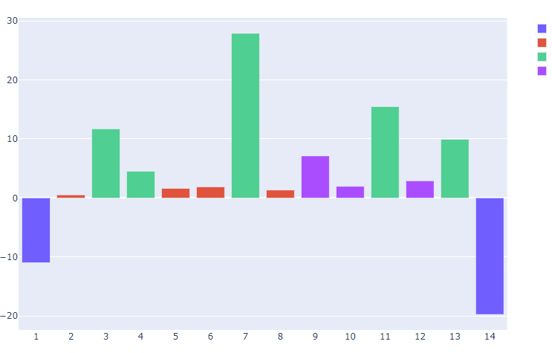
Analysis: System Upgrade
Cases that span the upgrade
% Difference in Mean Model Cost
30
20
10
0
-10
-20
Atmospheric
CPUs
72
1728
1800
3456
% Difference
Case ID

Slide 42
Analysis: System Upgrade
Cases that span the upgrade
% Difference in Mean Model Cost
30
20
10
0
-10
-20
Atmospheric
CPUs
72
1728
1800
3456
% Difference
Case ID
Kruskal-Wallis:
No statistical significance

Slide 43
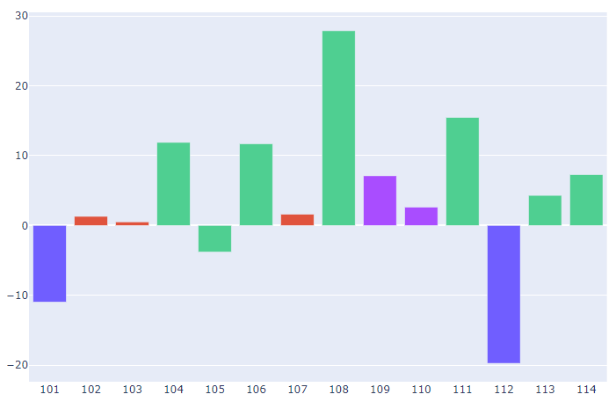
Analysis: System Upgrade
Bases that span the upgrade
% Difference in Mean Model Cost
30
20
10
0
-10
-20
Atmospheric
CPUs
72
1728
1800
3456
% Difference
Base ID

Slide 44
Analysis: System Upgrade
Bases that span the upgrade
% Difference in Mean Model Cost
30
20
10
0
-10
-20
Atmospheric
CPUs
72
1728
1800
3456
% Difference
Base ID
Kruskal-Wallis:
No statistical significance

Slide 45
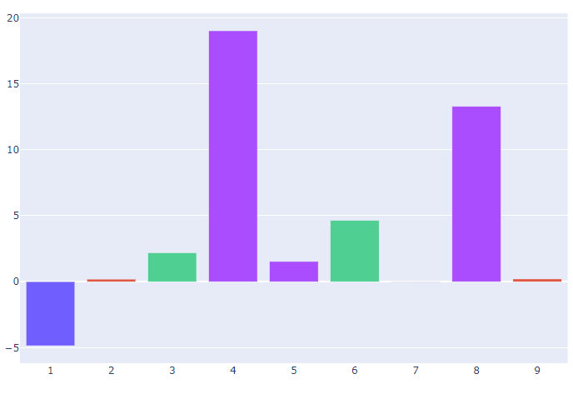
Analysis: System Upgrade
Groups that span the upgrade
% Difference in Mean Model Cost
20
15
10
5
0
-5
Atmospheric
CPUs
1080
1800
1728
3456
% Difference
Group ID

Slide 46
Analysis: System Upgrade
Groups that span the upgrade
% Difference in Mean Model Cost
20
15
10
5
0
-5
Atmospheric
CPUs
1080
1800
1728
3456
% Difference
Group ID
Kruskal-Wallis:
No statistical significance

Slide 47
Conclusion
More analysis in my Jupyter Notebook that points to performance degradation after the upgrade
Enormous amounts of information to be sliced and diced by each component, physics module, number of processors, and other settings specific to parallel computing
Answers lead to more questions
Academic
Users
Cheyenne

Slide 48
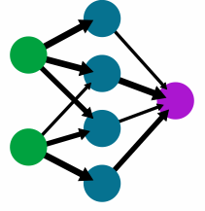
Future Work
Machine Learning
Correlation Plots
Feature Engineering
Supervised Learning to Predict Performance (Model Cost) using SVMs, Random Forest
Unsupervised Learning (K-Means) to reveal patterns

Slide 49
Acknowledgements
John Dennis
Brian Dobbins
NCAR mentors
Alice Bertini
NCAR SQL Training
AJ Lauer
Virginia Do
NCAR intern managers
Michael Busch
Nate George
Professors at Regis University
References
Balaji, et. al. CPMIP: Measurements of Real Computational Performance of Earth System Models in CMIP6. Geoscience Model Development Issue 10. January 02, 2017. https://www.geosci-model-dev.net/10/19/2017/
Images
Unless otherwise noted, graphics are from www.vecteezy.com

Slide 50
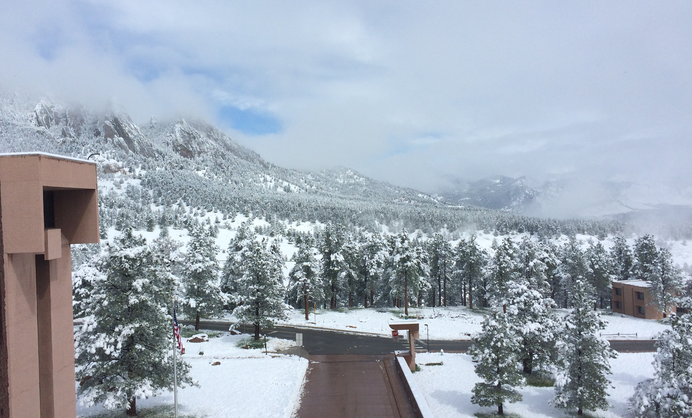
Questions?
Lolita Mannik
lolita@FourWindsPublications.com
This presentation is posted at: www.FourWindsPublications.com

